Slide 1



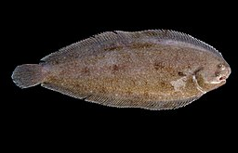

Are warming temperatures accelerating fish growth? A case study of Common sole in North East Atlantic waters
Kelly Diaz
Promotor: Prof. Dr. Marleen De Troch, UGent
Co-Promotor: Dr. Jochen Depestele, ILVO
Karen Bekaert, ILVO
Drs. Tuan-Anh Bui, UGent and ILVO

Slide 2
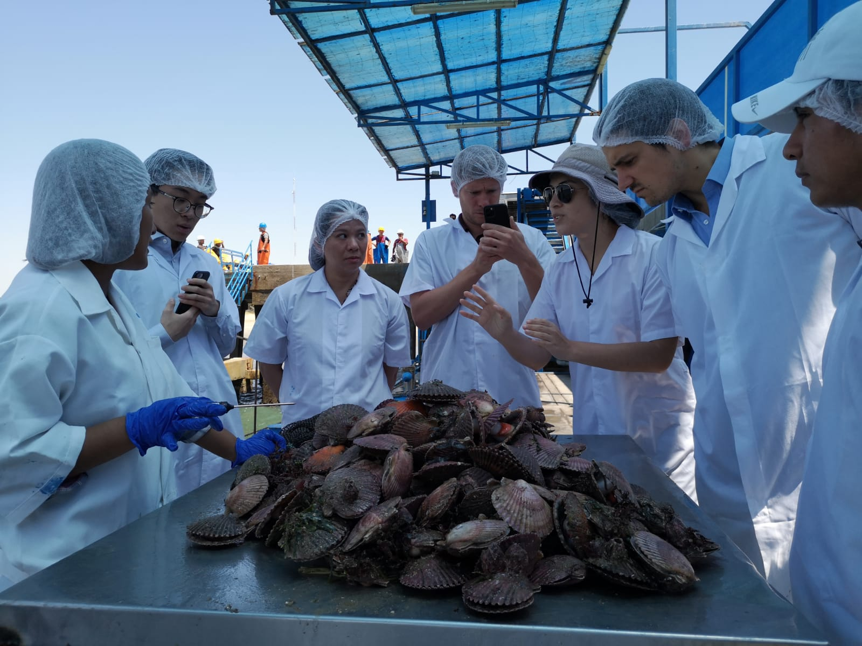
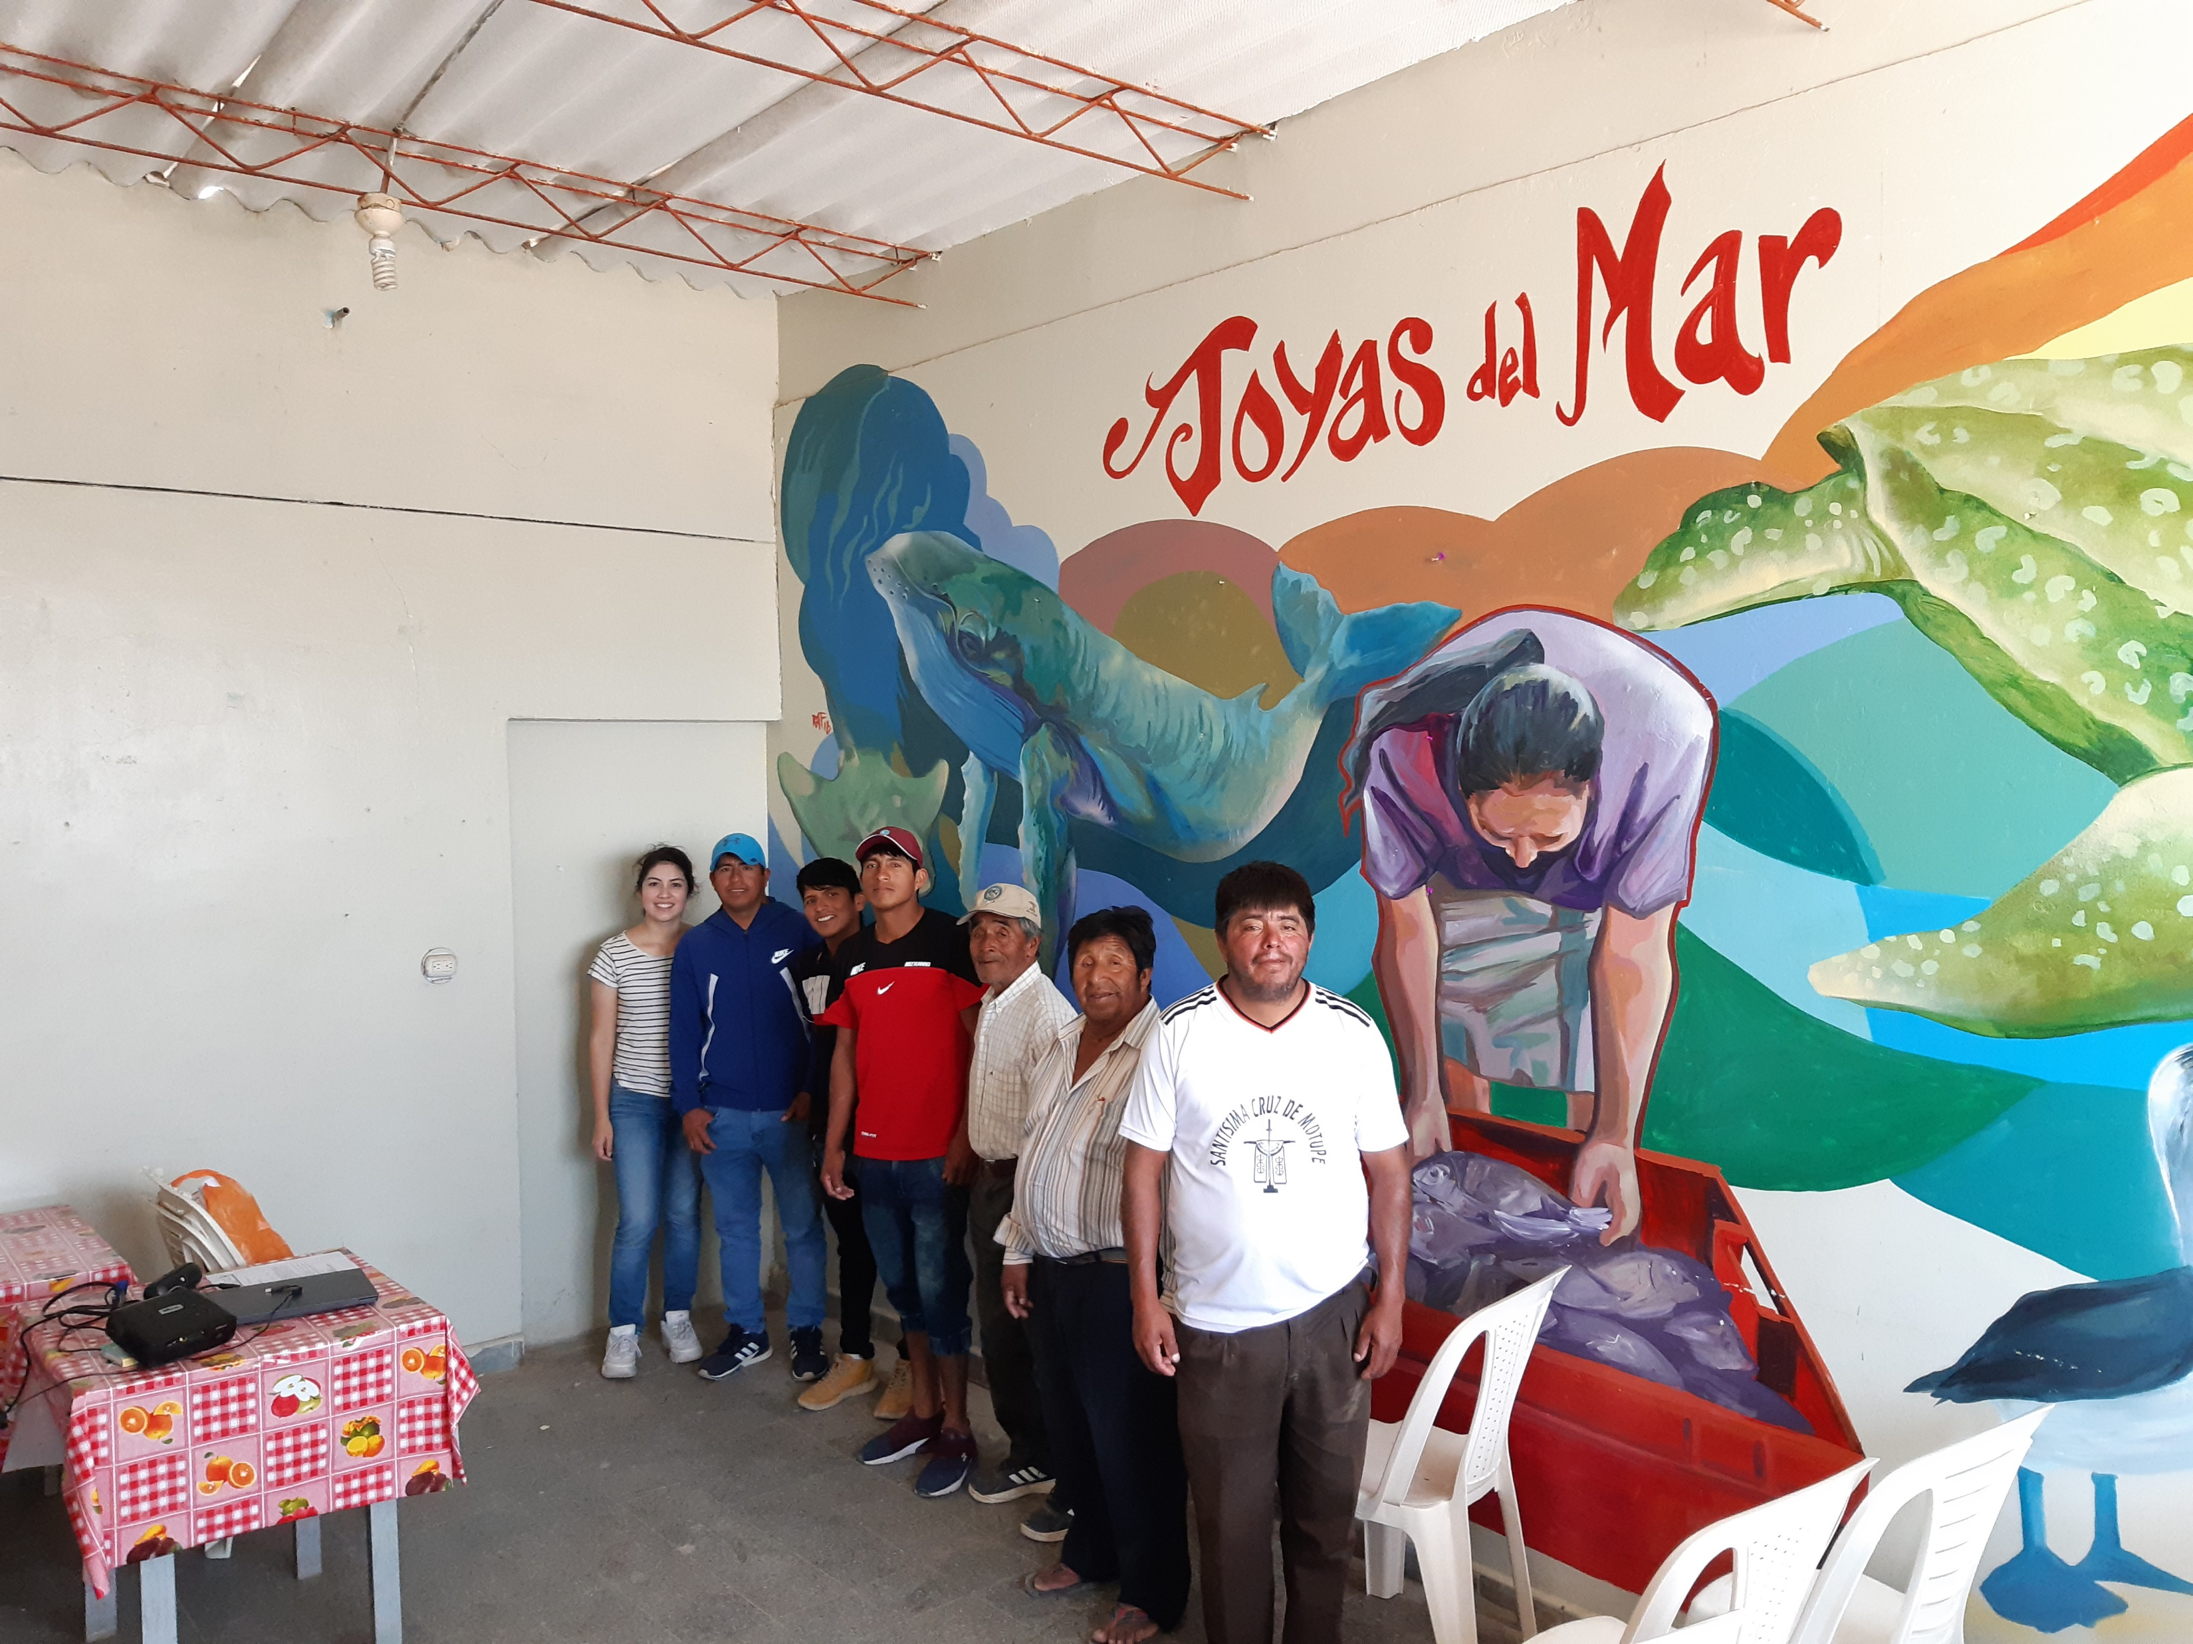
Introducing myself: Kelly Diaz
Piura, Peru
Bachelor’s degree: Wildlife and Wildlands Conservation, BYU
Experience: artisanal fisheries and industrial fisheries
Notes:
Who am I?

Slide 3
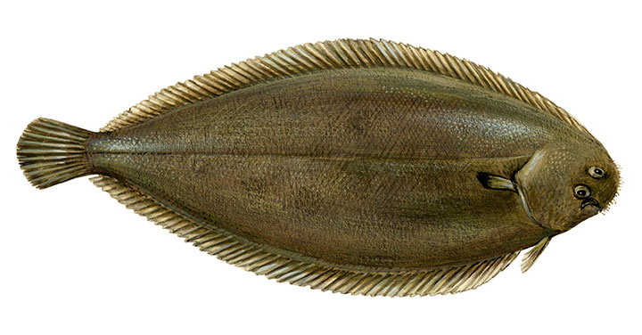
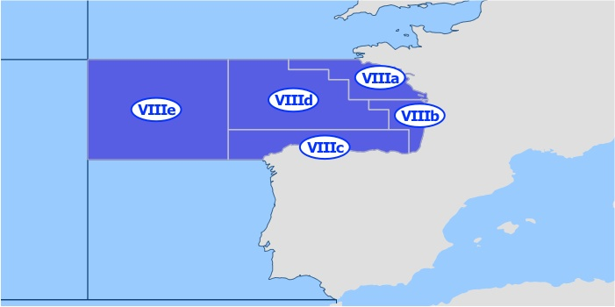
Thesis project
Common sole (Solea solea), a flatfish species.
Bay of Biscay (8a and 8b, in ICES Fishing areas).
How is fish growth affected by warming temperatures?
Temperature size rule (TSR) states that: when faced by warmer temperatures, fish would grow faster but reach smaller maximum sizes overall.

Slide 4
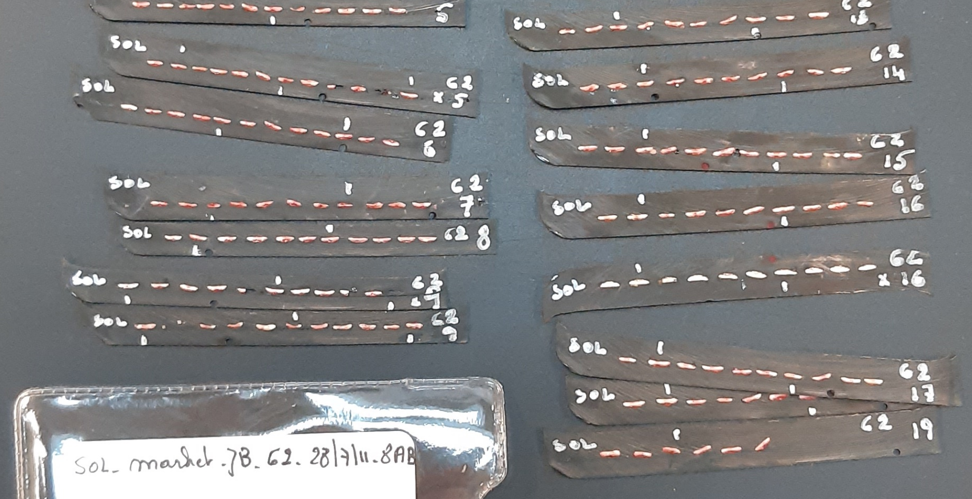
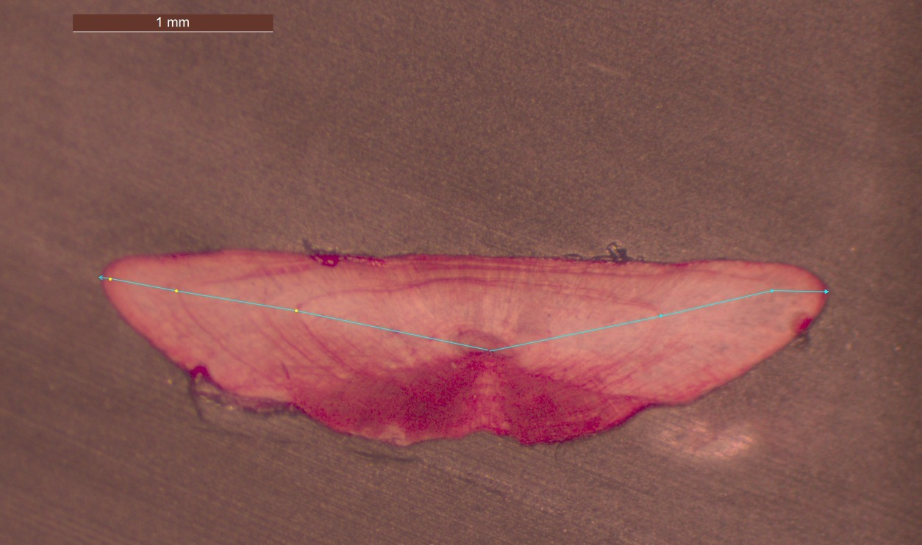
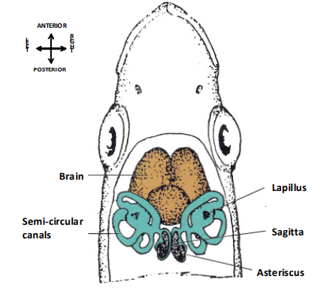
Work being done
Otoliths of Solea solea from ILVO archives.
Laboratory: Otolith selection. Samples from 1989 to 2020 (checked ~6500 otoliths, selected ~350).
Measurement: SmartDots software. Count and measure otolith rings.
Analyze with additional data (bottom temperature and fishing pressure).
Linear Regression.
Notes:
Tools/ methodology/type of work that is planned

Slide 5
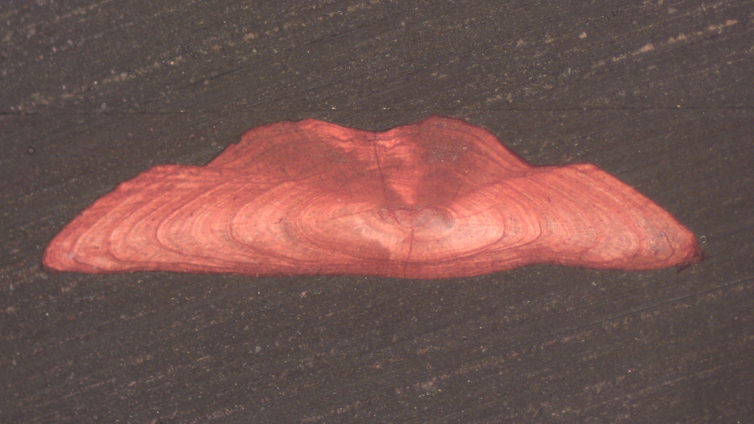
Thank you!
Notes:
Where do I struggle with?

